Slide 1

Chicago Crime Rates
By- Spoorthi Gunuganti, Srishti Kabtiyal, Trisha Chandra

Slide 2
Introduction
Chicago’s overall crime rate is substantially higher than the US average
Dataset contains details regarding reported crime scenes from 2012 – 2017 ~ 1M rows
Big data technologies to predict arrest for a reported crime

Slide 3






Technology Stack
R ~ Data Cleaning
Tableau, Python ~ Charts, Graphs
AWS ~ Hosting the data
Pyspark/Databricks ~ Model creation
Tableau Live ~ Interactive front end for visualizations

Slide 4
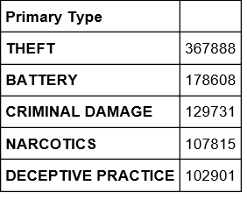
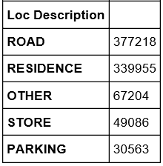
Trends/Discoveries
• Most Common types- Theft, Battery, Criminal Damage, Narcotics , Deceptive Practices
• Locations most prone to crime- Road, Residence, Other, Store, Parking

Slide 5
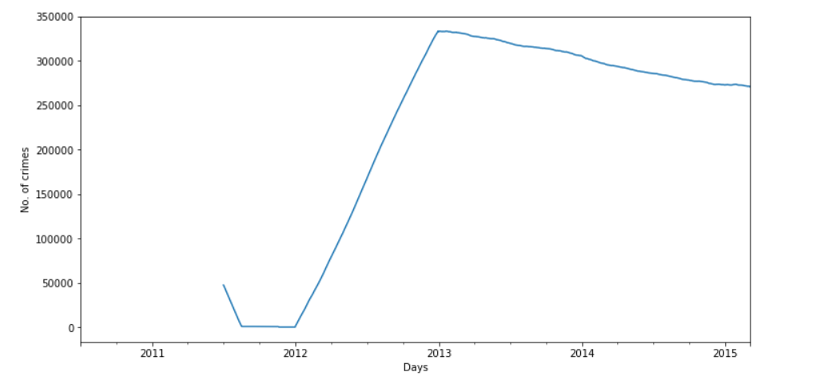
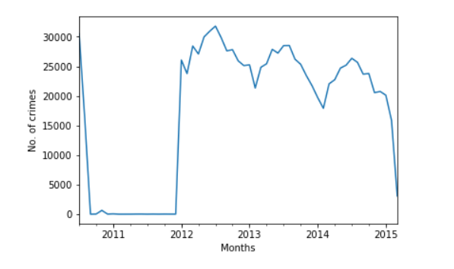
Trends/Discoveries
• Created using Python
• Decreasing trends discovered till 2016
*Crime rate on daily basis *Crime rate on monthly basis

Slide 6

Data Cleaning & Transformation
Date time transformation in R
Parsed dates in Python
Binning times into hours in R
Got rid of NAs
Dropped irrelevant columns
Transformation of Primary types and Location description
Indexing and assembling of
appropriate variables in pyspark

Slide 7
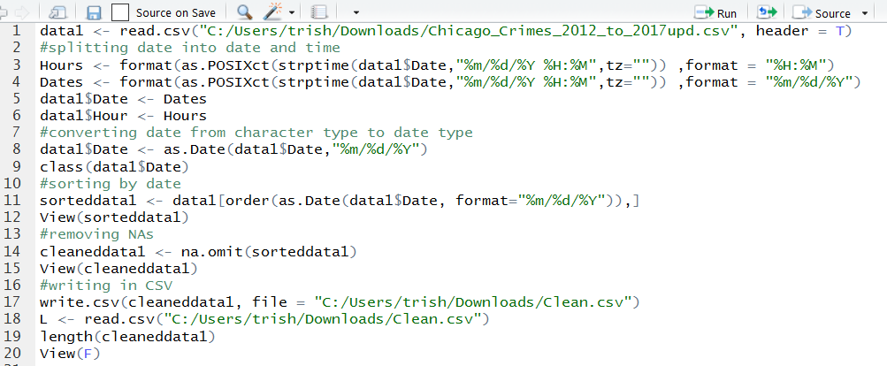
Data Cleaning & Transformation

Slide 8
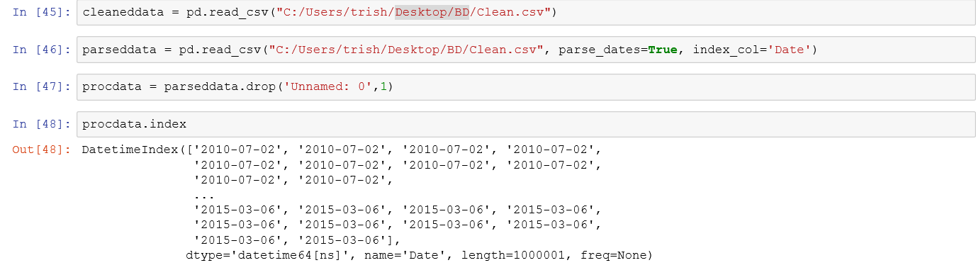
Data Cleaning & Transformation

Slide 9
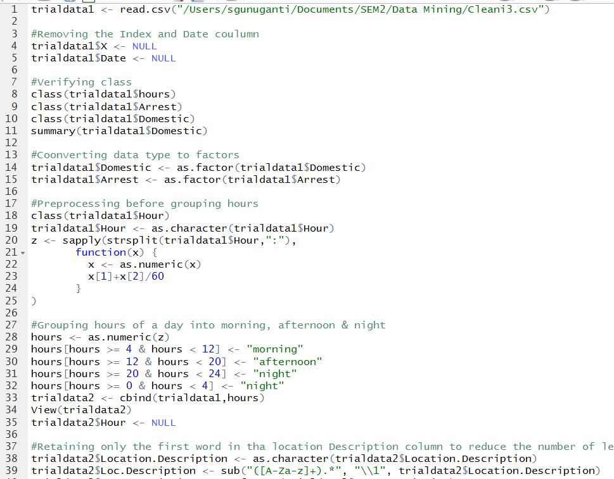
Data Cleaning & Transformation
Notes:
Continuing with the data cleaning
We removed a few of the columns, as they were either composite variables of already existing columns or columns that add no particular value to the regression analysis.
We Grouped the time of day into 3; morning, day and night
next for location description; we got only the first word in the column and then grouping them to reduce the number of factors.

Slide 10
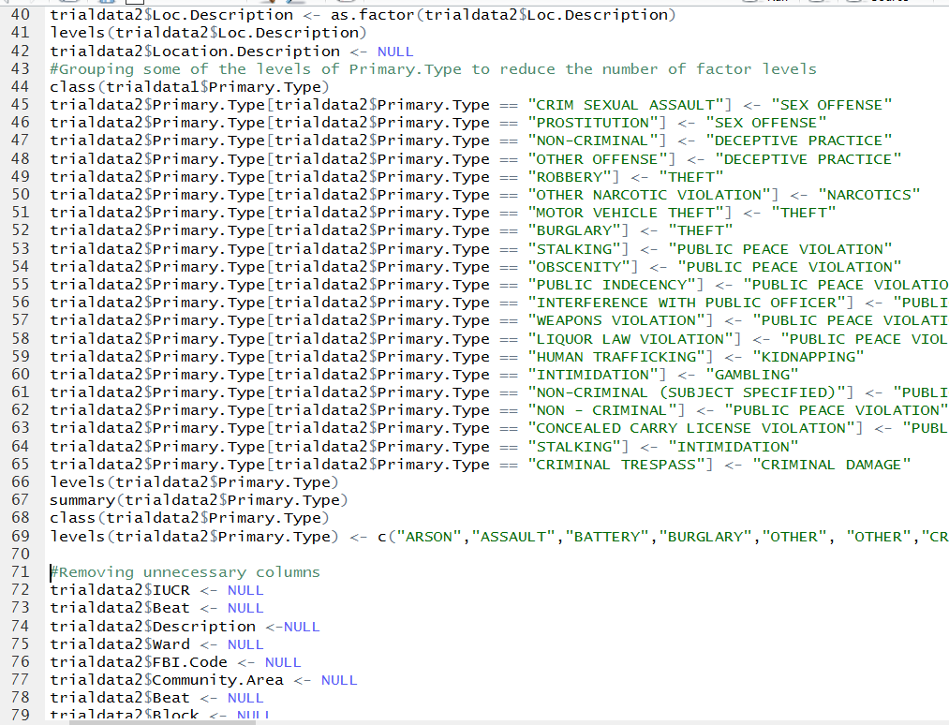
Data Cleaning & Transformation
Notes:
Did something similar for primary type as well.

Slide 11
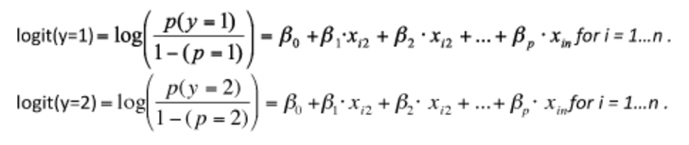
Binomial Logistic Regression
Predictive analysis used to describe data
Explains relationship between one dependent and one
or more independent variables.
Performed using Pyspark.
Dependent variable ~ Arrest – Whether an arrest
happened for a reported crime.
Notes:
Finally, Our aim is to perform binomial regression to predict arrest or not; for the given input variables.
To this end, we are splitting the data 70:30; into training and test respectively.

Slide 12
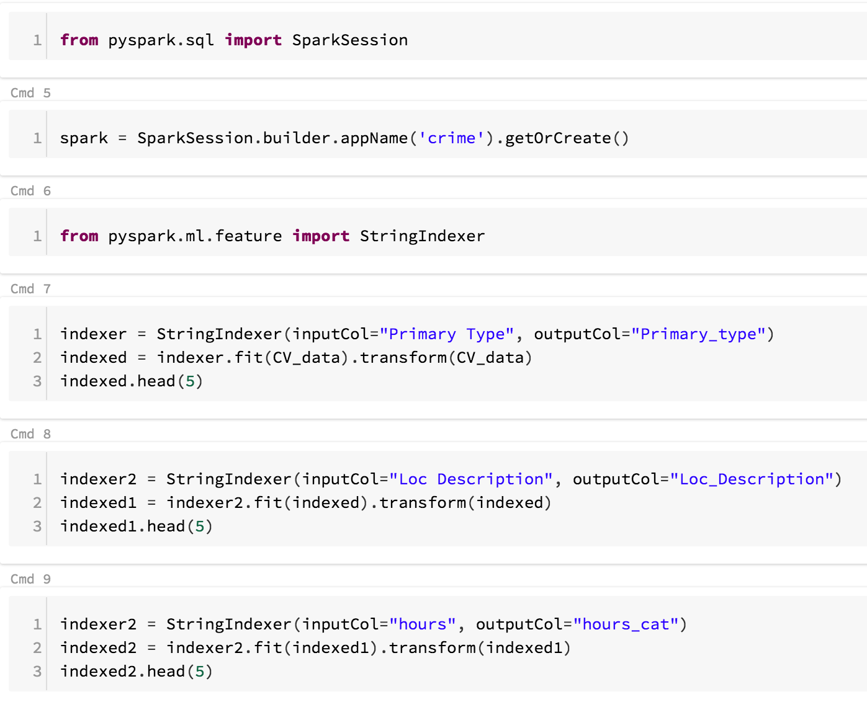
Data Preprocessing in PySpark
Notes:
Before we train the model; since we have a couple of string variables we use string indexer to convert them into factors.

Slide 13
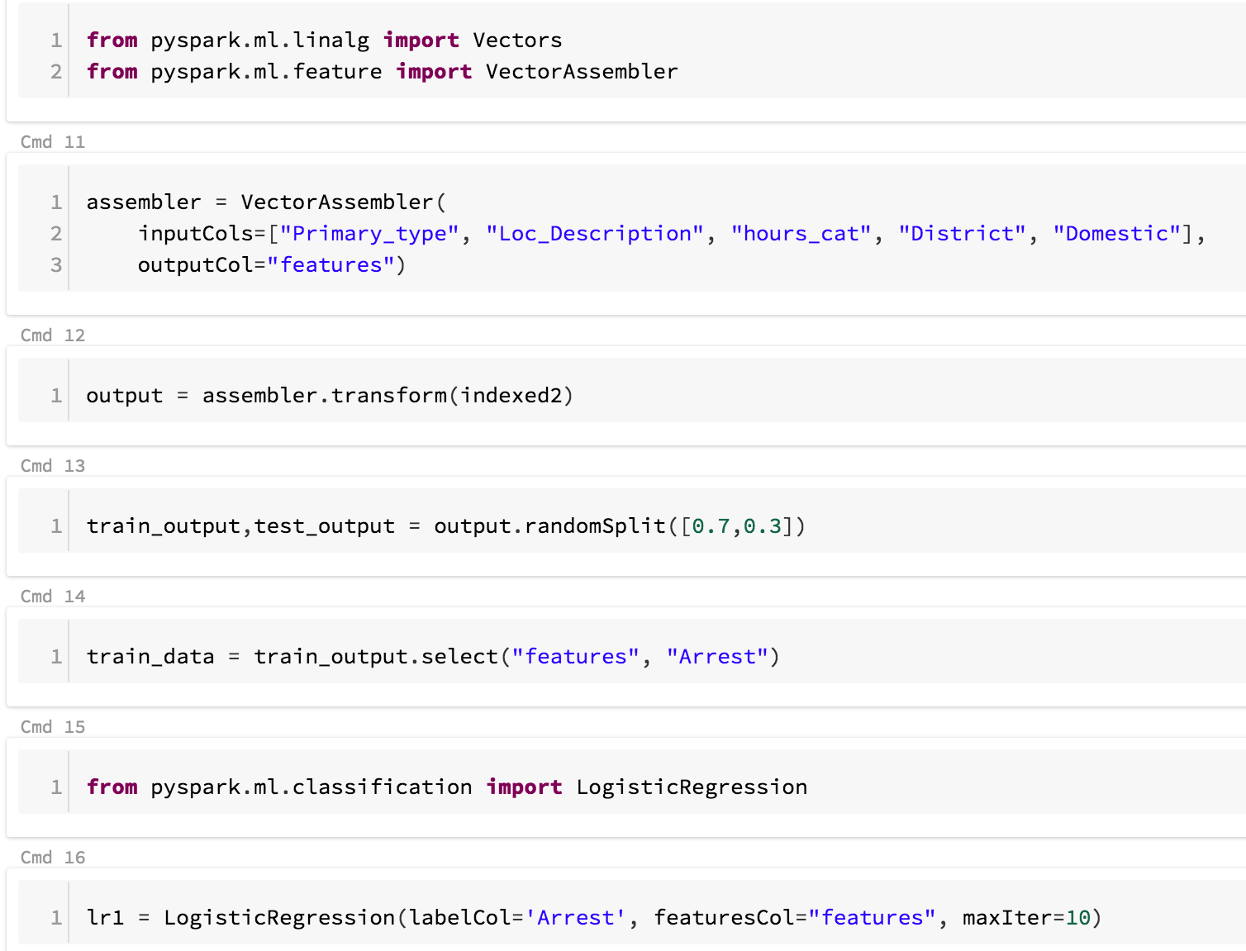
Implementation in PySpark
Notes:
Utilising the vector assembly function; All the input variables are grouped into a single vector column called features.
Logistic regression function is used to train the model and then transform function for prediction on the test data.
We converted both the output dataset and test data to pandas to perform merge.
the dataframe obtained was relocated to AWS in the form of a csv

Slide 14
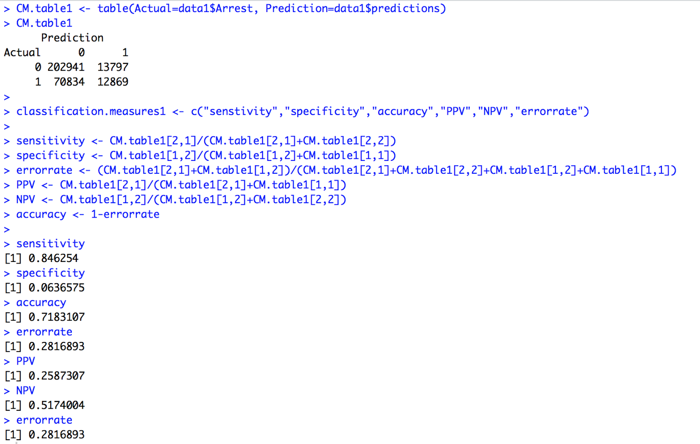
Prediction & Performance Parameters
Notes:
We compared our prediction results to actual test data and obtained the following performance evaluation metrics
Accuracy- 71%
Sensitivity- 0.84
Error rate- 0.28

Slide 15

Front End - Tableau
http://terpconnect.umd.edu/~sgunugan/
Notes:
We have created an HTML webpage and linked it to our tableau dashboards we created using the predicted dataset.
The webpage contains various tabs pertaining to the charts and dashboards we have created.
If you click on a tab, you’ll be shown the chart corresponding to it. For eg., the Pred-hourly basis tab shows the values of predicted arrests vs no arrests for morning, afternoon and evening time slot.
Predictions- all parameters tab shows a detailed analysis of the number of arrests corresponding to all independent variables.
You can also see the values for predicted arrests for select independent variables through the two dashboards we have created.
Predictions based on location and Predictions based on primary type charts show the predicted number of arrests pertaining to a selected location or primary charts.

Slide 16
Conclusions
Fascinating to work on crime dataset consisting of about
1M rows
Big data tools such as Pyspark makes it easier to handle
large datasets and perform analysis
Crimes are a serious issue plaguing the society. Big data
technology is one of the most important tools that can
be put to use to tackle the issue

Slide 17


